Slide 1
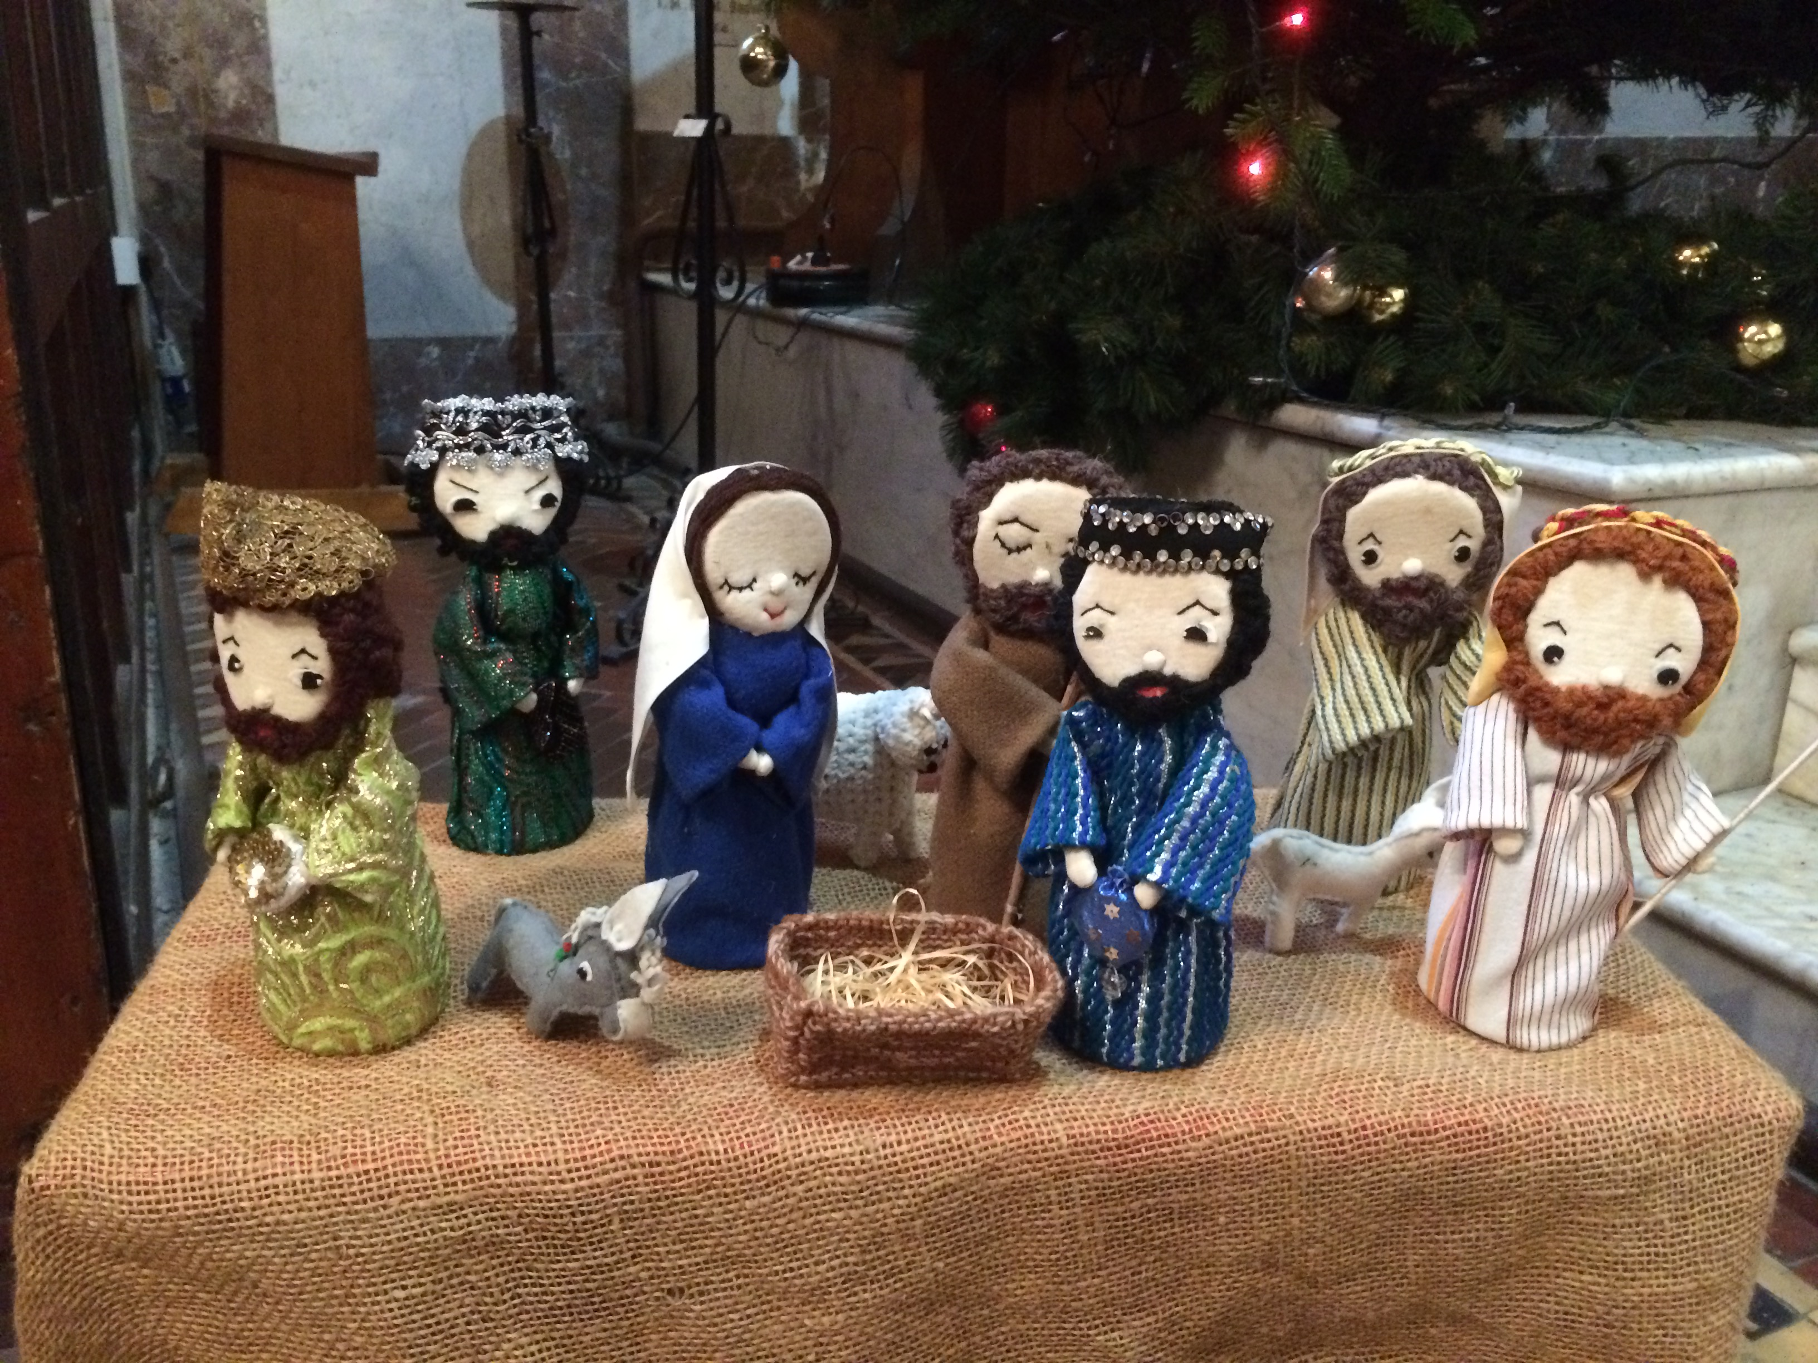
Advent Assembly
© Jacqui Wilkinson, CIC, DCU

Slide 2
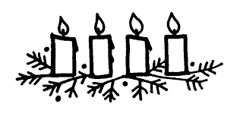
Greeting
The Lord be with you
And also with you.
This is the day that the Lord has made.
We will rejoice and be glad in it.

Slide 3
This time of year is called ADVENT
It is a time of waiting and preparing for Christmas

Slide 4
Song
Here is an example of an Advent hymn you can sing or listen to or you may have a school favourite.
Make way, make way https://www.youtube.com/watch?v=alCQ7fb0hEA
Start at 15 seconds in

Slide 5
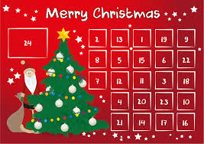
In Advent
We are listening!
We are watching!
We are waiting in joyful hope for the coming of our Saviour Jesus Christ

Slide 6
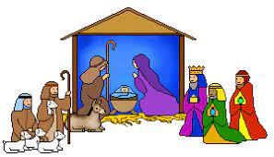
In assembly today
We are going to go back in time to the day before the very first Christmas and listen to stories of people who were waiting for the birth of Jesus.
We are travelling back about 2000 years, before cars, TVs, planes, phones or computers.

Slide 7
BETHLEHEM
STOP 1
Early Christmas Eve

Slide 8
The Inn at Bethlehem
Bethlehem was a busy place because Caesar Augustus had decided to take a census. He wanted to know how many people lived in his country. Then he could make rules and collect taxes from everyone.
Everyone had to sign the census in the town or city that their family had come from.
There were lots of visitors in Bethlehem….lots of people needing rooms to spend the night. Rooms were running out. Late visitors would not get anywhere to stay.
NO ROOM

Slide 9
On the road to Bethlehem
STOP 2
Evening time Christmas Eve

Slide 10
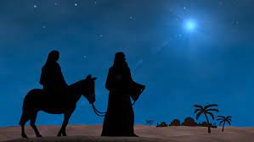
The Road from Nazareth to Bethlehem
Mary and Joseph had packed at home in Nazareth. They were on a long journey to Bethlehem because Joseph’s family came from that town.
The journey was long and was very difficult for Mary and Joseph because Mary was going to have a baby very soon.
They must have been getting worried as they got nearer to Bethlehem, what would they do if all the inns were full? What if their baby was born?
The only way to travel from Nazareth to Bethlehem was on foot. This is why the traditional carol ‘Little Donkey’ imagines Mary and Joseph on their journey, with Mary on the donkey’s back.

Slide 11
Song
Little Donkey
Little Donkey
https://www.youtube.com/watch?v=j7_aqEYS668

Slide 12
A hill overlooking Bethlehem
STOP 3
Night time
Christmas Eve

Slide 13
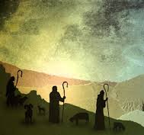
On the hills
Out on the hills near Bethlehem were shepherds.
It was night time and cold. Stars were in the sky.
The shepherds were protecting their sheep from predators and thieves. They probably spent a few hours gathering all the sheep together to settle them in a sheep pen where they could be safe for the night.
You can imagine the shepherds then sitting down together and talking and telling stories.
That night might have felt a bit different – did the shepherds feel that something was going to happen?

Slide 14
Far away, in the land of the kings
STOP 4
Night time
Christmas Eve

Slide 15
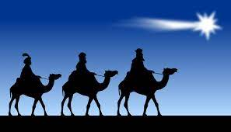
The land of the kings
We have travelled far away from Bethlehem now. To the land where the kings or wise men lived.
The Bible tells us that they studied the stars, watching for new stars to appear in the night sky.
They believed that a new star appeared
when a king was born.
They were ready to travel to follow the star
and find the king.
Tradition says they came from the east and travelled across lands which were desert like. That is why the wise men or kings are often shown with camels.

Slide 16
Everything is ready.
The innkeeper’s inn is full and there are no empty rooms
Mary and Joseph are nearly at Bethlehem

Slide 17
The shepherds are out on the hills and it is a clear starry night
The kings are watching the stars and waiting

Slide 18
Everything is ready
But we too need to wait…

Slide 19
What are we doing at home and in school to prepare to celebrate the birth of Jesus?

Slide 20
In Advent
We are listening!
We are watching!
We are waiting in joyful hope for the coming of our Saviour Jesus Christ

Slide 21
Let us pray
Heavenly Father, through this season of Advent, we prepare for our Christmas celebrations of the birth of your Son Jesus Christ.
In all the busy times this term, help us to see the importance of your love for us. Show us new ways to share the message of your love for all people. We pray this in the name of Jesus, whose coming we eagerly await. Amen.
(© Praying Together, 2020)

Slide 22
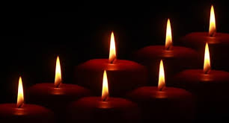
Jesus taught us to call God our Father, so in faith and trust we pray
Our Father who art in heaven,
hallowed be thy name,
Thy kingdom come,
Thy will be done,
on earth as it is in heaven.
Give us this day our daily bread.
Forgive us our trespasses as we
forgive those who trespass against us.
Lead us not into temptation
but deliver us from evil.
For thine is the kingdom, the power and the glory
For ever and ever, Amen.

Slide 23
Ár nAthair, atá ar neamh,
go naofar d’ainm,
go dtaga do ríocht,
go ndéantar do thoil ar talamh
mar a dhéantar ar neamh.
Ár n-arán laethúil tabhair dúinn inniu.
Agus maith dúinn ár bhfiacha,
mar a mhaithimidne dár bhféichiúna féin.
Agus ná lig sinn i gcathú,
ach saor sinn ón olc.
Óir is leatsa an ríocht, agus an chumhacht
agus an ghlóir, trí shaol na saol. Áiméan

Slide 24
In Advent
We are listening!
We are watching!
We are waiting in joyful hope for the coming of our Saviour Jesus Christ

Slide 25
Advent
Assembly
© Jacqui Wilkinson, CIC, DCU.

