Slide 1
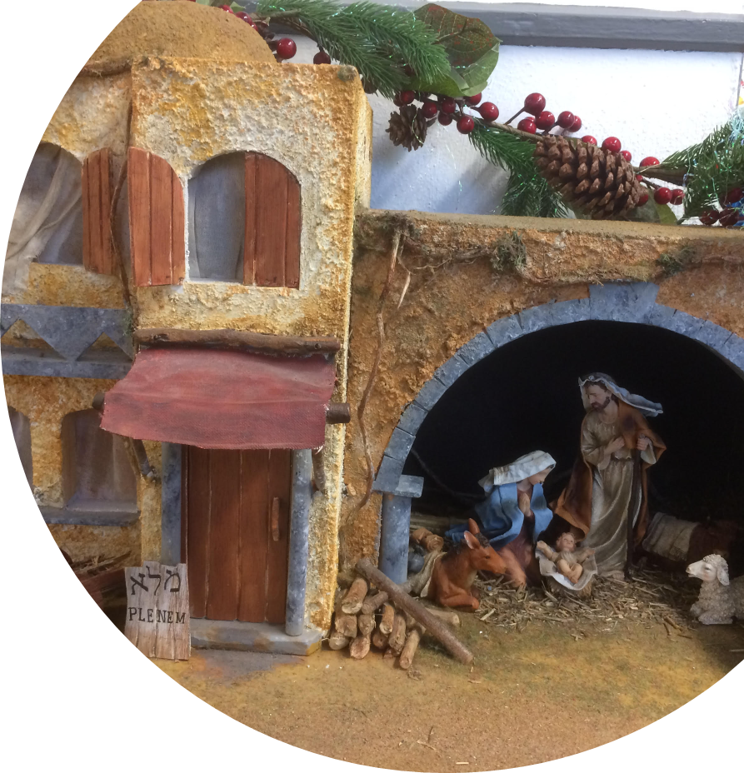
CHRISTMAS
Assembly
© Jacqui Wilkinson, CIC, DCU

Slide 2
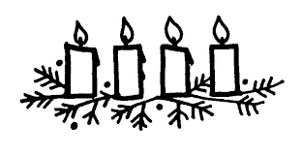
Greeting
The Lord be with you
And also with you.
This is the day that the Lord has made.
We will rejoice and be glad in it.

Slide 3
During ADVENT…
we were waiting and preparing for Christmas

Slide 4
We heard stories of
the innkeeper waiting
Mary and Joseph waiting

Slide 5
the shepherds waiting
and the wise men or kings waiting

Slide 6
Now let’s hear the stories of what happened when the waiting was over…

Slide 7
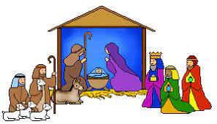
In assembly today
We are going to go back in time to the first Christmas and listen to stories of people who had been waiting for the birth of Jesus.
Remember, we are travelling back about 2000 years.

Slide 8
BETHLEHEM
STOP 1
Christmas Eve

Slide 9
The Inn at Bethlehem
Mary and Joseph had a long journey from Nazareth to Bethlehem so that they could register in the census.
When they were in Bethlehem, the time came for Mary to have her baby.
She gave birth to her first son.
There were no rooms left in the inn. So she wrapped the baby in cloths and laid him in a box where animals are fed.
adapted from Luke 2:4-7
NO ROOM

Slide 10
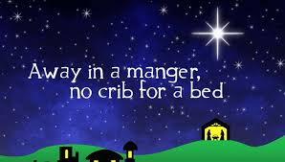
Song
Away in a manger
https://www.youtube.com/watch?v=9CJFt7BZKUU

Slide 11
A hill overlooking Bethlehem
STOP 2
Night time
Christmas Eve

Slide 12
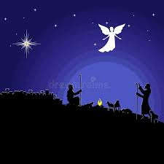
On the hills
It was night time and cold. Stars were in the sky.
Out on the hills near Bethlehem were shepherds watching their sheep. An angel of the Lord stood before them. The glory of the Lord was shining around them and suddenly they became very frightened. The angel said to them.
‘Don’t be afraid, because I am bringing you some good news. It will be a joy to all the people. Today your Saviour was born in Bethlehem. He is Christ the Lord. This is how you will know him, you will find a baby wrapped in cloths and lying in a feeding box’.

Slide 13
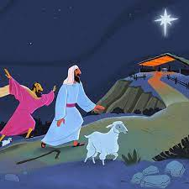
On the hills
Then a very large group of angels from heaven joined the first angel. All the angels were praising God, saying:
‘Give glory to God in heaven, and on earth let there be peace to the people who please God’
Then the angels left the shepherds and went back to heaven. The shepherds said to each other, ‘Let us go to Bethlehem and see this thing that has happened. We will see what the Lord has told us about.
So the shepherds went quickly and found Mary and Joseph. And the shepherds saw the baby lying in a feeding box. Then they told them what the angels had said about this child.
Everyone was amazed when they heard what the shepherds said to them.

Slide 14
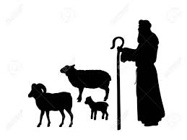
On the hills
Then the shepherds went back to their sheep, praising God and thanking him for everything they had seen and heard. It was just as the angel had told them.
(adapted from Luke 2:8-20)
How do you think the angels felt when they saw the baby?
I wonder how they explained what had happened that night?
I wonder if they ever heard stories about Jesus again and if they remembered that night and the angels, and the baby.

Slide 15
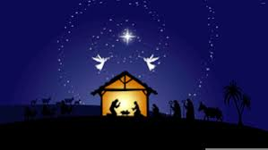
Song
The first Nowell tells the story of the shepherds
While shepherds watched their flocks by night is another carol telling the story
The first Nowell
https://www.youtube.com/watch?v=D5uud2fjtoo
Up to 3.08 mins (before the kings)

Slide 16
Far away, in the land of the kings
STOP 3
Night time
Christmas Eve

Slide 17
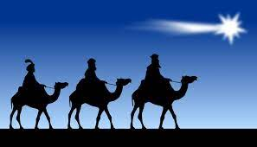
The land of the kings
We have travelled far away from Bethlehem now. To the land where the kings or wise men lived.
The Bible tells us that they studied the stars, watching for new stars to appear in the night sky.
They believed that a new star appeared
when a king was born.
They were ready to travel to follow the star
and find the king.
That night a new star appeared, and the kings set out to worship the new king.
They won’t arrive yet ……we celebrate that day on 6 January .

Slide 18
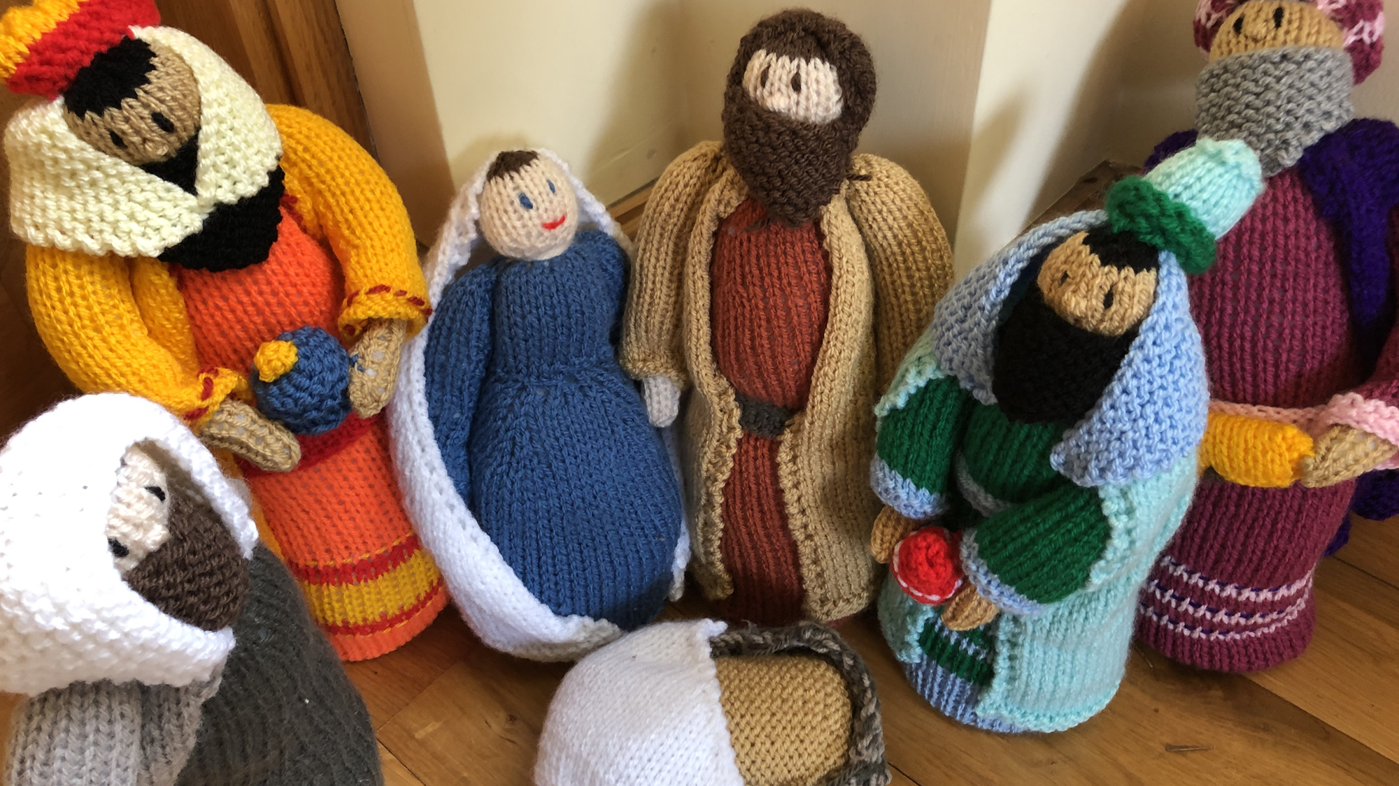
Let us pray..
Heavenly Father as we get closer to Christmas with all its excitement may we enjoy the special times at home with our families. We also pray for those children for whom this Christmas may be sad or lonely. As we give and receive presents, we pray that we will always remember the true meaning of Christmas – the birth of your son Jesus. Amen

Slide 19
Let us pray..
Heavenly Father, may this Christmas be a time of sharing, giving, love and happiness. Thank you Lord for this wonderful occasion and for our friends and family. On this occasion please help those who are less fortunate and lonely. Thank you for Christmas, a time that unites all friends and families. Amen
© Praying Together 2020.

Slide 20
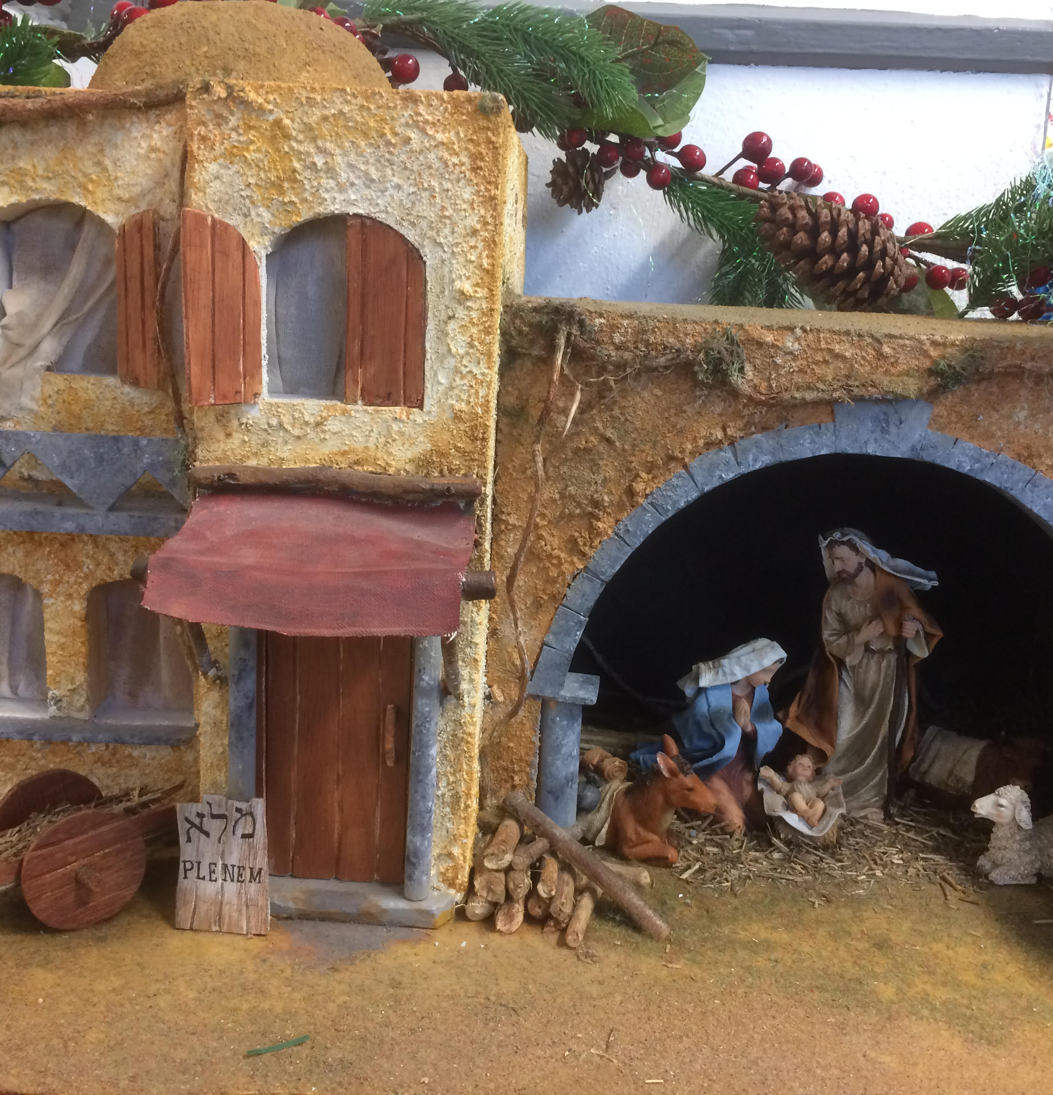
Jesus taught us to call God our Father, so in faith and trust we pray
Our Father who art in heaven,
hallowed be thy name,
Thy kingdom come,
Thy will be done,
on earth as it is in heaven.
Give us this day our daily bread.
Forgive us our trespasses as we
forgive those who trespass against us.
Lead us not into temptation
but deliver us from evil.
For thine is the kingdom, the power and the glory
For ever and ever, Amen.

Slide 21
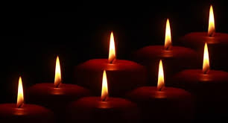
Ár nAthair, atá ar neamh,
go naofar d’ainm,
go dtaga do ríocht,
go ndéantar do thoil ar talamh
mar a dhéantar ar neamh.
Ár n-arán laethúil tabhair dúinn inniu.
Agus maith dúinn ár bhfiacha,
mar a mhaithimidne dár bhféichiúna féin.
Agus ná lig sinn i gcathú,
ach saor sinn ón olc.
Óir is leatsa an ríocht, agus an chumhacht
agus an ghlóir, trí shaol na saol. Áiméan

Slide 22
CHRISTMAS
Assembly
© Jacqui Wilkinson, CIC, DCU.

