Slide 1
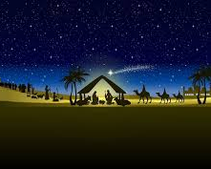
Gifts at Christmas
© Jacqui Wilkinson, CIC, DCU.

Slide 2
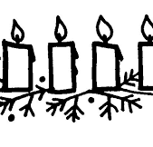
Greeting
The Lord be with you
And also with you.
This is the day that the Lord has made.
We will rejoice and be glad in it.

Slide 3
We are looking forward to Christmas gifts or presents. But what have gifts got to do with the Christmas story?

Slide 4
The Bible Reading
Matthew 2:1-12

Slide 5
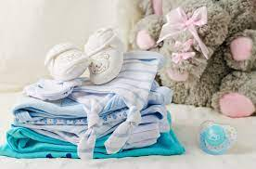
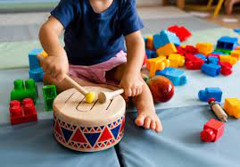
What kinds of gifts do people give to a new born baby?

Slide 6
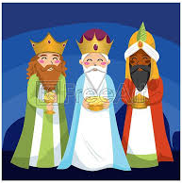
The wise men or magi in our story brought different gifts. Can you remember what they were?

Slide 7
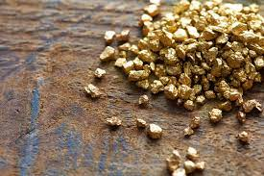
The wise men or magi gave Jesus three gifts
GOLD
This was an expensive valuable gift that would be given to a king.
Jesus would be a great king

Slide 8
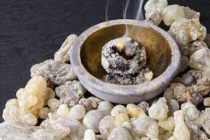
The wise men or magi gave Jesus three gifts
Frankincense
Incense has been used for thousands of years in worship.
Jesus would be a holy man

Slide 9
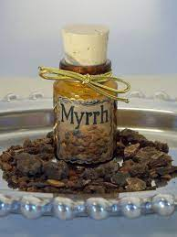
The wise men or magi gave Jesus three gifts
Myrrh
This was a perfumed lotion used to show people were very special, it was traditionally used when someone died.
Jesus was going to die

Slide 10
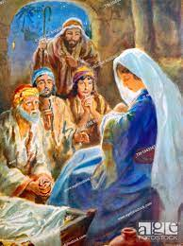
What do you give if you have nothing?
The shepherds in the story of Jesus’ birth didn’t have gold, frankincense or myrrh.
Do you think they gave anything to the new baby Jesus?

Slide 11
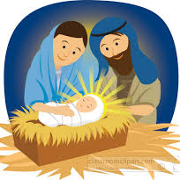
In the bleak mid-winter
There is a traditional Christmas carol called In the Bleak Midwinter.
One verse says:
What can I give Him,
Poor as I am?
If I were a shepherd
I would bring a lamb,
If I were a wise man
I would do my part,
Yet what I can I give Him,
Give my heart.
(Christina Rossetti)

Slide 12
We are all getting excited about giving and receiving gifts this Christmas

Slide 13
The carol talked about giving gifts that can’t be touched or seen – ‘Yet what can I give him? Give my heart’

Slide 14
That might mean gifts like love, peace, kindness, helpfulness, caring for others, generosity, justice

Slide 15
You might think of other gifts that would make the world a better place, things we can all do without spending money.

Slide 16
You could write your ideas on heart shaped pieces of paper or gift tags and hang them on the Christmas tree or put them beside the crib.

Slide 17
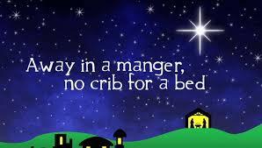
Song
Away in a manger
https://www.youtube.com/watch?v=9CJFt7BZKUU
This is a favourite Christmas hymn

Slide 18
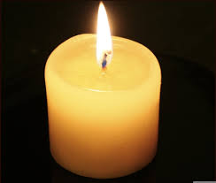
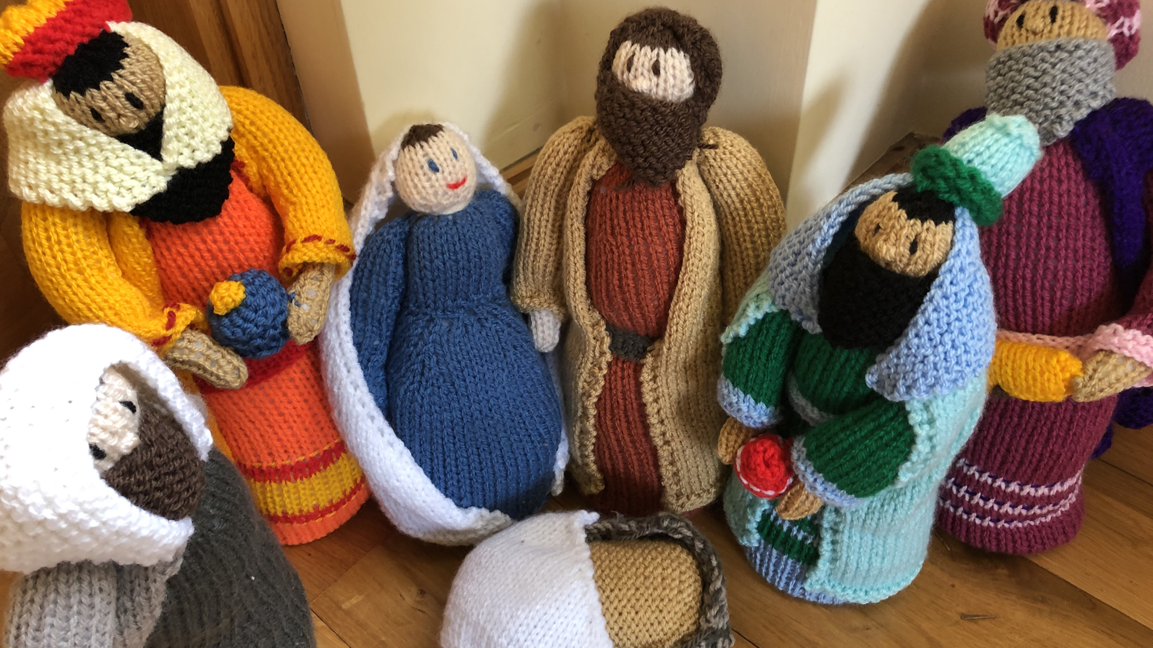
Let us pray
Heavenly Father as we get closer to Christmas with all its excitement may we enjoy the special times at home with our families. We also pray for those children for whom this Christmas may be sad or lonely. As we give and receive presents, we pray that we will always remember the true meaning of Christmas – the birth of your son Jesus. Amen.
Dear God help us to remember the real meaning of Christmas and the birth of Jesus. Please help the homeless and less fortunate this Christmas. May everyone have a safe and warm Christmas with family and friends. Give us hope and joy this Christmas. Amen.
Heavenly Father, may this Christmas be a time of sharing, giving, love and happiness. Thank you Lord for this wonderful occasion and for our friends and family. On this occasion please help those who are less fortunate and lonely. Thank you for Christmas, a time that unites all friends and families. Amen
© Praying Together 2020.

Slide 19
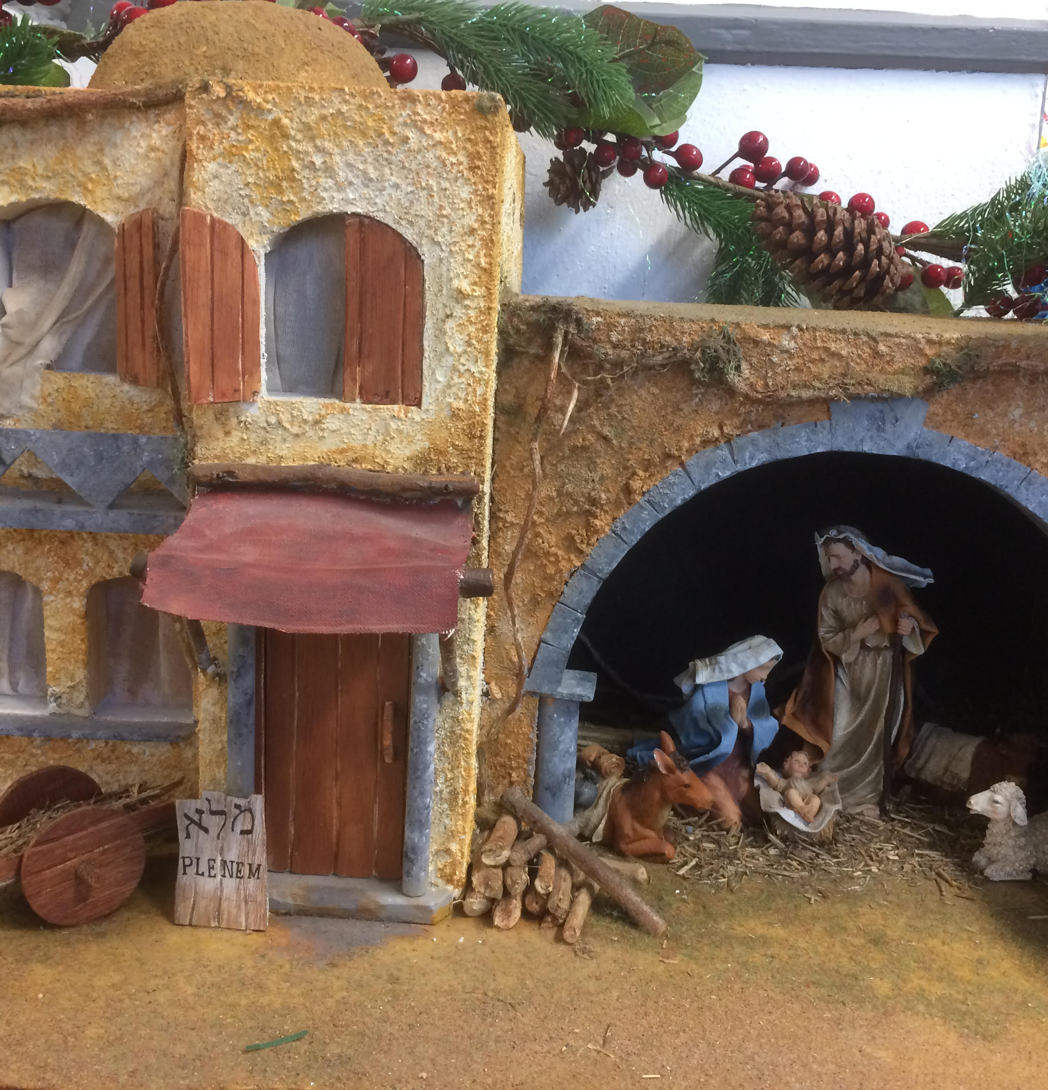
Jesus taught us to call God our Father, so in faith and trust we pray
Our Father who art in heaven,
hallowed be thy name,
Thy kingdom come,
Thy will be done,
on earth as it is in heaven.
Give us this day our daily bread.
Forgive us our trespasses as we
forgive those who trespass against us.
Lead us not into temptation
but deliver us from evil.
For thine is the kingdom, the power and the glory
For ever and ever, Amen.

Slide 20
Gifts at Christmas
Assembly
© Jacqui Wilkinson, CIC, DCU

