Slide 1
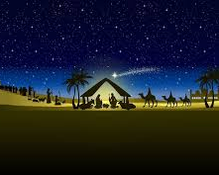
The Christmas Crib
School Assembly
© Jacqui Wilkinson, CIC, DCU

Slide 2
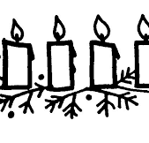
Greeting
The Lord be with you
And also with you.
This is the day that the Lord has made.
We will rejoice and be glad in it.

Slide 3
Have you a Christmas crib in your classroom or school?

Slide 4
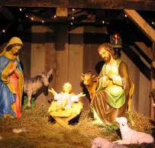
At this time of year people all around the world display Christmas cribs as they decorate their homes, schools and churches for Christmas
Some look like this:

Slide 5
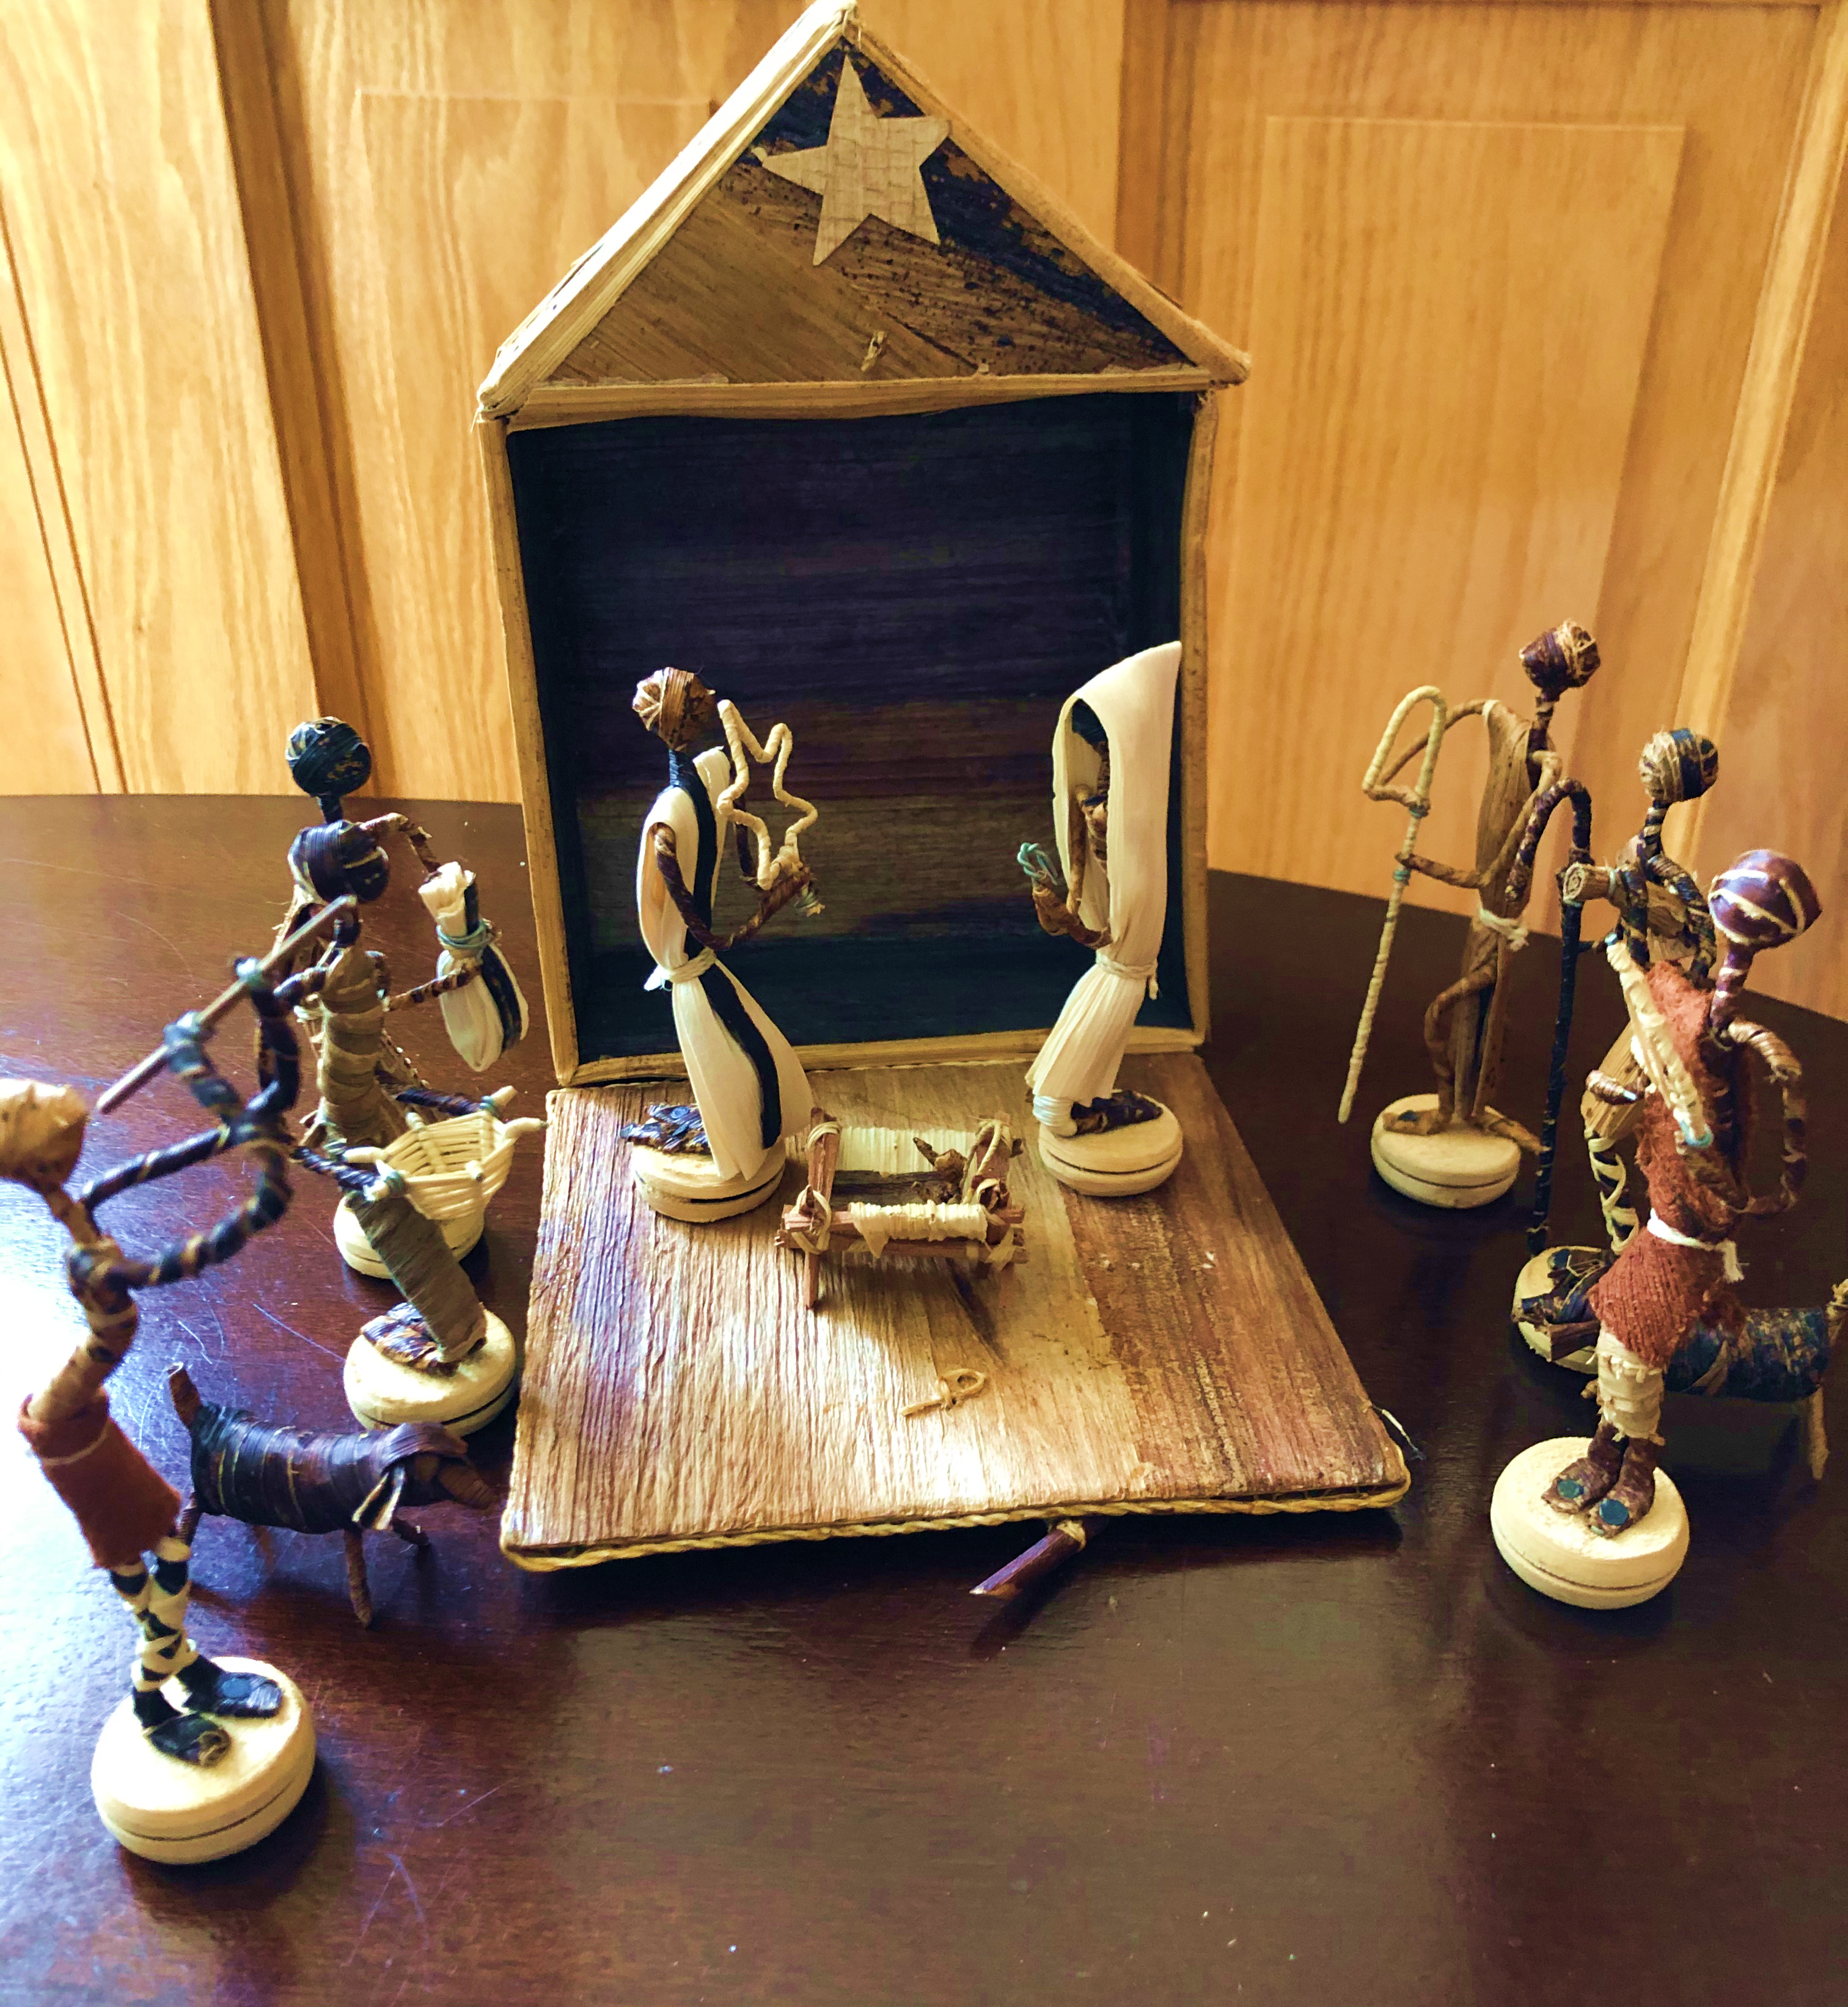
Some may look like these

Slide 6
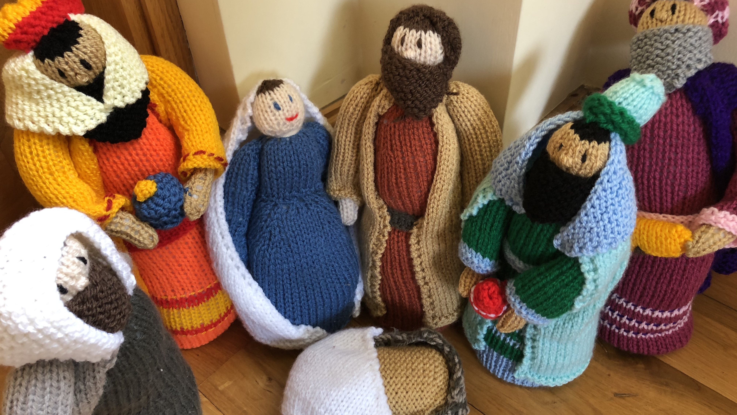
Or others like this

Slide 7
What they all have in common is:
The characters
Mary
Joseph
Shepherds
Kings or Wise men
Animals
And the manger which is usually left empty until Christmas Day

Slide 8
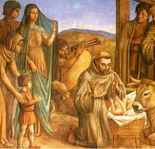
Legend tells us
St Francis of Assisi was the first person to make a crib. After a visit to Bethlehem he returned to Italy wanting to make the story come alive for the people there. He felt that the people he was talking to knew nothing about what the stable could have been like.
He arranged a Christmas service in a cave on the hillside outside his village. He made it look like a stable with live animals. Villagers dressed as the characters and Francis preached to the people from beside the manger so they could see what the story of the birth of Jesus was really like.

Slide 9
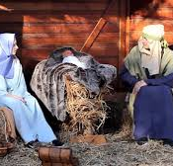
Years later
The king of Naples made figures for a Christmas crib and the queen and other court ladies dressed them. Other Christmases he asked artists and sculptors to make the figures. Soon it became very popular to have cribs in villages and homes all over Italy and further afield.
Some towns and cities in Ireland have had cribs with live animals or people. Other places link the crib with charity fundraising such as the Share crib in Cork and the Mansion House crib in Dublin

Slide 10
The Bible Reading
Luke 2: 1-7

Slide 11
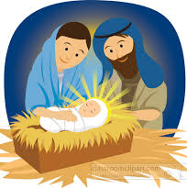
Mary and Joseph
At that time, Augustus Caesar sent an order to all people in the countries that were under Roman rule. The order said that they must list their names in a register. This was the first registration taken while Quirinius was governor of Syria. And everyone went to their own towns to be registered.
So Joseph left Nazareth, a town in Galilee. He went to the town of Bethlehem in Judea. This town was known as the town of David. Joseph went there because he was from the family of David. Joseph registered with Mary because she was engaged to marry him. (Mary was now pregnant.) While Joseph and Mary were in Bethlehem, the time came for her to have the baby. She gave birth to her first son. There were no rooms left in the inn. So she wrapped the baby with cloths and laid him in a manger where animals are fed.

Slide 12
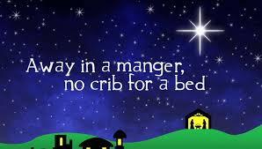
Song
Away in a manger
https://www.youtube.com/watch?v=9CJFt7BZKUU
This is a favourite Christmas hymn

Slide 13
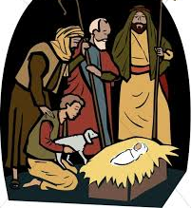
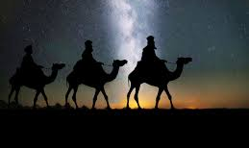
You can read the story of the shepherds and the wise men arriving at the manger too.
Luke 2:8-15 tells the story of the shepherds
Matthew 2: 1-12 tells the story of the wise men or kings

Slide 14
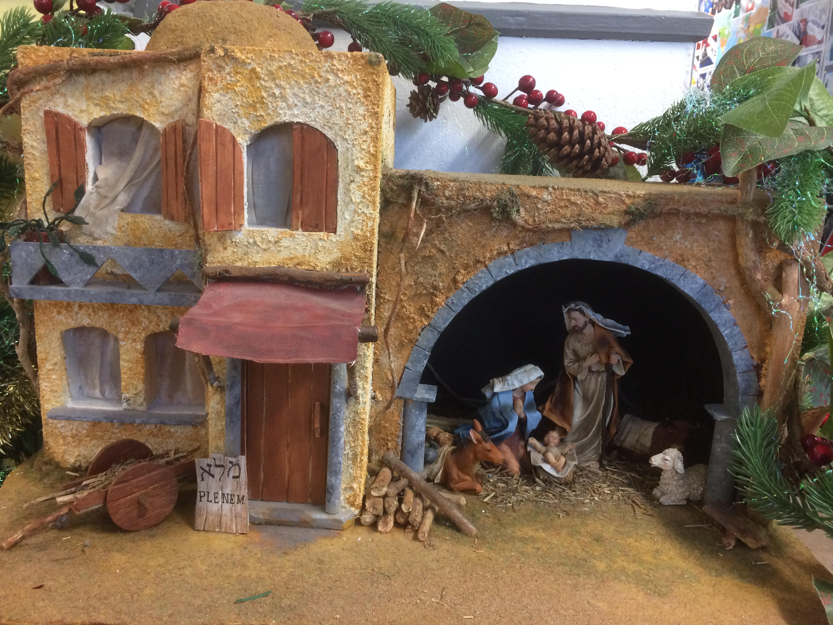
When you look at a crib in school or in a shopping centre or church
Think about why St Francis made the first crib
To tell the story of the first Christmas

Slide 15
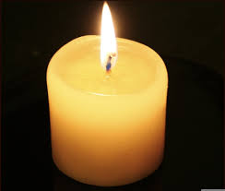
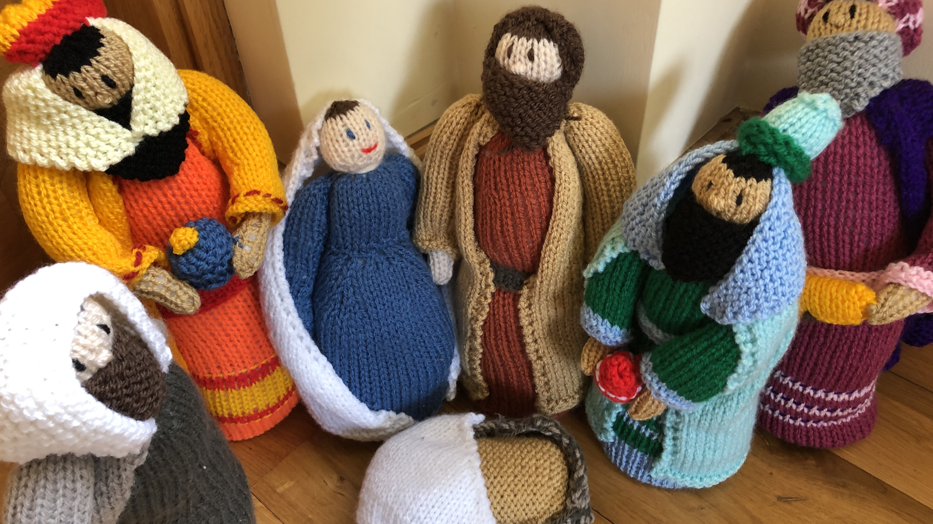
Let us pray
Heavenly Father as we get closer to Christmas with all its excitement may we enjoy the special times at home with our families. We also pray for those children for whom this Christmas may be sad or lonely. As we give and receive presents, we pray that we will always remember the true meaning of Christmas – the birth of your son Jesus. Amen.
Dear God help us to remember the real meaning of Christmas and the birth of Jesus. Please help the homeless and less fortunate this Christmas. May everyone have a safe and warm Christmas with family and friends. Give us hope and joy this Christmas. Amen.
Heavenly Father, may this Christmas be a time of sharing, giving, love and happiness. Thank you Lord for this wonderful occasion and for our friends and family. On this occasion please help those who are less fortunate and lonely. Thank you for Christmas, a time that unites all friends and families. Amen
© Praying Together 2020.

Slide 16
Jesus taught us to call God our Father, so in faith and trust we pray
Our Father who art in heaven,
hallowed be thy name,
Thy kingdom come,
Thy will be done,
on earth as it is in heaven.
Give us this day our daily bread.
Forgive us our trespasses as we
forgive those who trespass against us.
Lead us not into temptation
but deliver us from evil.
For thine is the kingdom, the power and the glory
For ever and ever, Amen.

Slide 17
The Christmas Crib
© Jacqui Wilkinson, CIC, DCU.

