Slide 1

Mothering Sunday
School Assembly

Slide 2
Notes for teachers
Be aware of sensitivities for this assembly in the school before use.
The first slide asks the children to talk about the name for the day. Both are correct.
Some examples of mothers in the Bible are Mary, Moses’ mother and Hannah - Samuel’s mother, Their stories are included in the Stepping Out (1st class) Follow Me lesson about Mothering Sunday; available in the older book version or in the updated digital version (from September 2026). If 1st class in your school have completed this lesson the children may be able to tell or dramatise one of the stories at a school assembly.
The slides at the end include “A word from…..” (this could be an update or news from the teacher, principal or Rector), student birthdays and Students of the Week. Please feel free to add to or remove slides as needed.
There are many versions of the simple song found online. One is below.
https://youtu.be/wtldb1WhDk4?si=bEJLXOZvFvXnSZg_

Slide 3

Chat: What do we call the day?
Is it Mothering Sunday?
Why?
Is it Mother’s day?
Why?

Slide 4
When is Mothering Sunday?
Mothering Sunday is always the fourth Sunday in Lent.
This year it is on _____________________.
We are having assembly in school on a different day but remembering and thinking about Mother’s Day.
Is there a service in our local church on Mothering Sunday?
Do you know the history of Mothering Sunday?

Slide 5
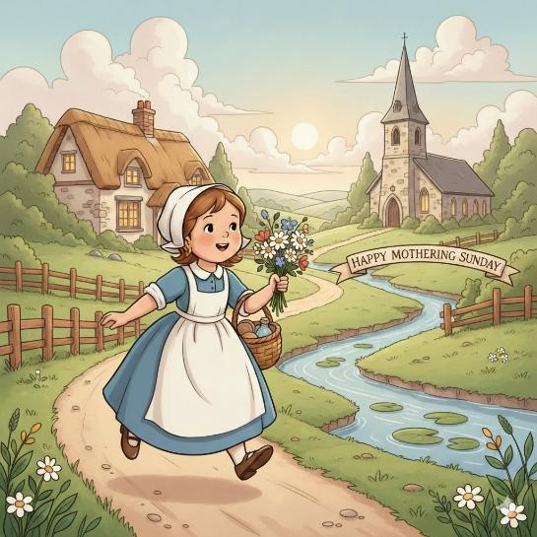
How did Mothering Sunday start?
Image created by AI Gemini
Traditionally years ago, it was a day when children who had gone to work as servants in big houses were given a day off to visit their mothers and family. On the walk home they might gather wildflowers to bring to their mother.
When the servants were in work they went to church services in the nearest church to their work, but when they went home they would go to church in their “mother” or home church.
Do you have a “mother” church? Where is our school’s Mother Church?

Slide 6
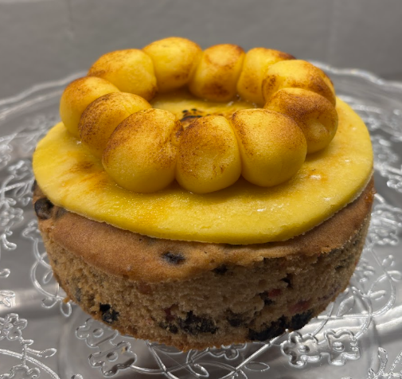
Did you know? Simnel Cake
There is a cake traditionally associated with Mothering Sunday.
Simnel Cake is a fruit cake made with a layer of marzipan or almond paste added to the top.
This cake is now more often associated with Easter. The 11 marzipan balls on the top of the Simnel cake represent 11 of Jesus’ 12 disciples. The missing disciple is Judas Iscariot who betrayed Jesus.

Slide 7
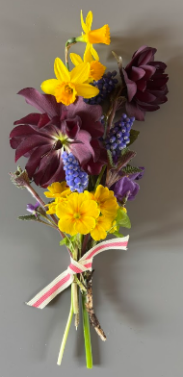
How do we celebrate Mother’s Day?
We might give our mums a card, flowers or a gift.
We might do something special for Mummy.
We might go out for dinner or a treat.
Some churches give the women a small bunch of Spring flowers.
We also remember people who care for us like mums, grandparents, aunts, Godmothers.
Don’t forget that men can be like Mums to some children.
Do you do anything special to celebrate in your home?

Slide 8

Bible
If you want to hear more stories about mothers in the Bible, you could look at the lesson on Mothering Sunday in Stepping Out. It is one of the 1st class Follow Me lessons.
Can you think of any mothers in the bible stories we know?
What words would you use to describe them?
The image above is updated Stepping Out, available on the Follow Me website from Autumn 2026.

Slide 9
What words describe your Mum?
What do you call your mother?
Think of three words that describe your mum.
Tell the person beside you.

Slide 10
Song (to the time of “You are my Sunshine”)
I love you Mummy,
My dearest Mummy,
You make me happy
when I am sad.
I want to tell you,
I really love you.
When I’m with you,
I am so glad.

Slide 11
Prayers
God of love, this Sunday we will be remembering all the mothers everywhere. We give thanks for their love for us, and that they are there for us when we are happy and when we are sad.
We also give thanks for the family of the church. Help us to remember that we are all part of God’s family and that we experience love and care through the church community too.
As we pray for all mothers, we do this in the name of Jesus Christ who also knew what it was to be loved by his mother too.
Amen
Praying Together

Slide 12
A word from………

Slide 13

Birthdays this week

Slide 14

Students of the Week

